Slide 1

IronHack Data Analytics
WEEK 4 | WORLD HAPPINESS DATASET
Group 4 - Elohor & Mike

Slide 2

IRONHACK BOOTCAMP DA JAN 31
Agenda
Project Overview
Business Opportunity
Datasets Overview
Major Obstacles & Lessons Learned
Exploratory Data Analysis
Conclusion and Insights

Slide 3

IRONHACK BOOTCAMP DA JAN 31
Project Overview
Looking to solve life’s great questions:
less_work = more_happiness? 🥹
more_work = more_money? 🤑
more_work = less_life? 💀

Slide 4

IRONHACK BOOTCAMP DA JAN 31
Who would be interested in these findings?
Businesses:
Improve employee well-being and productivity
Government agencies:
Provides insights into public policy and economic development

Slide 5
IRONHACK BOOTCAMP DA JAN 31
How do we uncover this?
Note: Data is shown as standardized scores
For Happiness data:
World Happiness Report (2015 - 2019)
Measures six factors across 140+ countries:
Happiness (Total Score - 10)
GDP per capita (World Bank)
Social support (Poll)
Healthy life expectancy (World Health Org)
Freedom to make life choices (Poll)
Generosity (Poll)
Perceptions of corruption (Poll)

Slide 6
IRONHACK BOOTCAMP DA JAN 31
How do we uncover this?
For the work data: 📈
Organisation for Economic Co-operation and Development (OECD)
Annual dataset on Average Hours Worked Per Year
Contains the average working hours per person, per year for 105 countries
Average Hours =
Average annual hours worked /
Average # of people in employment

Slide 7
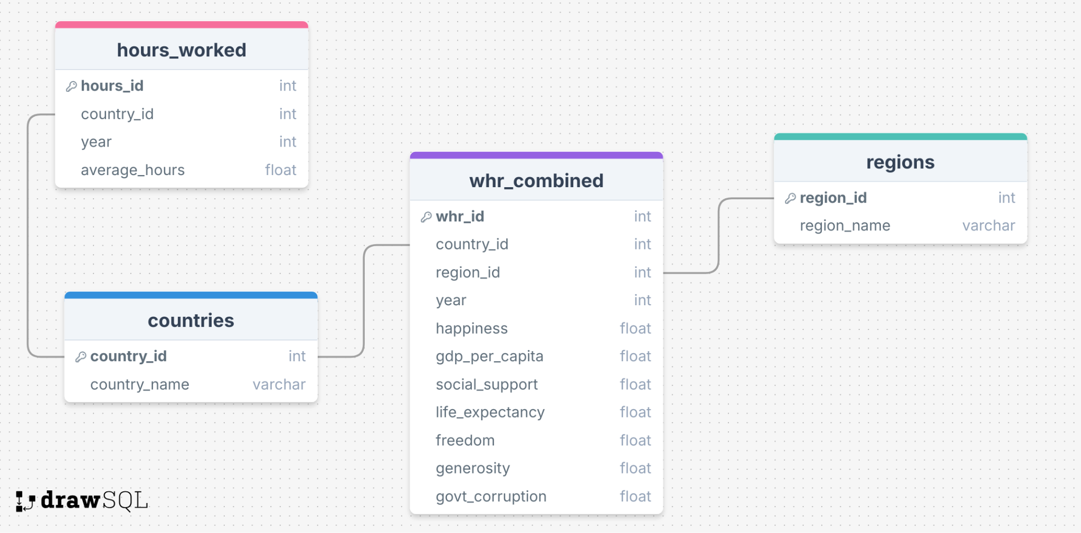
IRONHACK BOOTCAMP DA JAN 31
Obstacles & Lessons Learned
🔴 Issues:
Multiple id’s for the same year and country, causing data redundancy.
country and region are repeated text fields, making queries inefficient.
Notes:
Had some trouble deciding how to normalize our tables, because we had duplicate country and region names and duplicate year values and a mismatch of countries and regions between hours_worked and world_happiness_report
Decided to tackle this by creating tables with the common country and region data to store the values
This also sped up processing time by removing redundant text

Slide 8
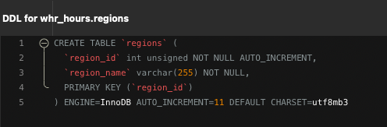
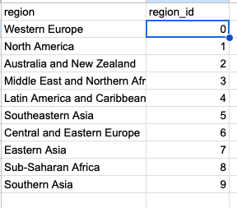
IRONHACK BOOTCAMP DA JAN 31
Obstacles & Lessons Learned
“Wait, where did europe go??”

Slide 9
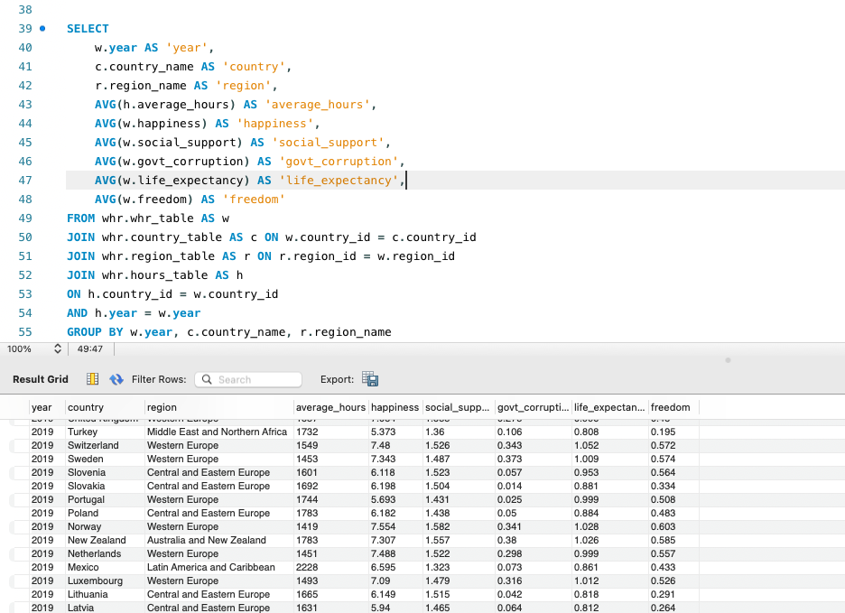
IRONHACK BOOTCAMP DA JAN 31
Obstacles & Lessons Learned
😍

Slide 10
IRONHACK BOOTCAMP DA JAN 31
more_work = more_money? 🤑

Slide 11
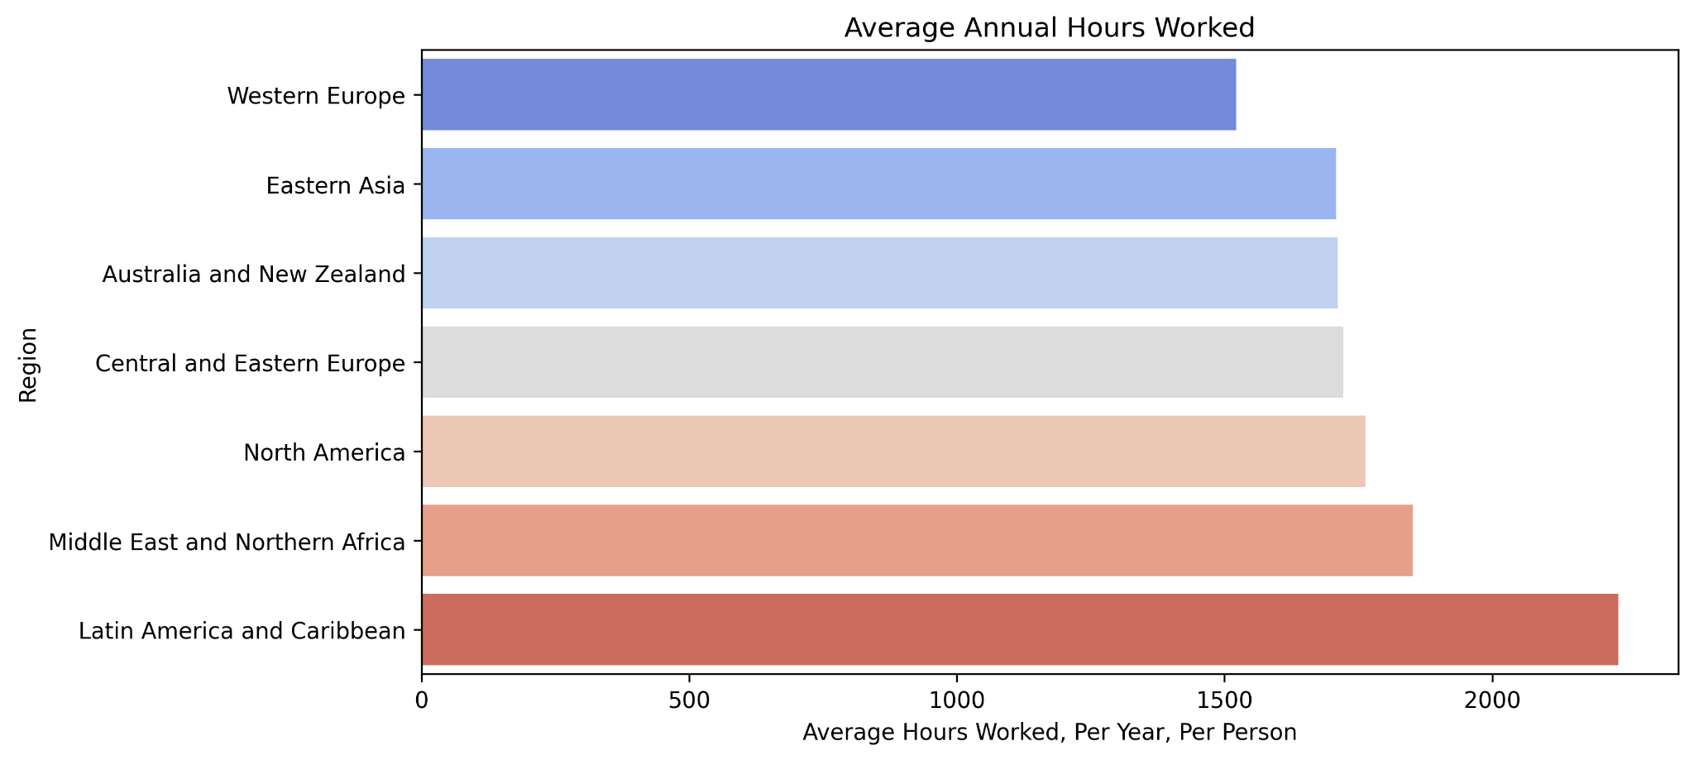
IRONHACK BOOTCAMP DA JAN 31
Who works the most?
People living in LATAM work 83 more days per year than Western Europeans*
* based on an 8-hour work day
Notes:
More developed regions show a trend of fewer working hours

Slide 12
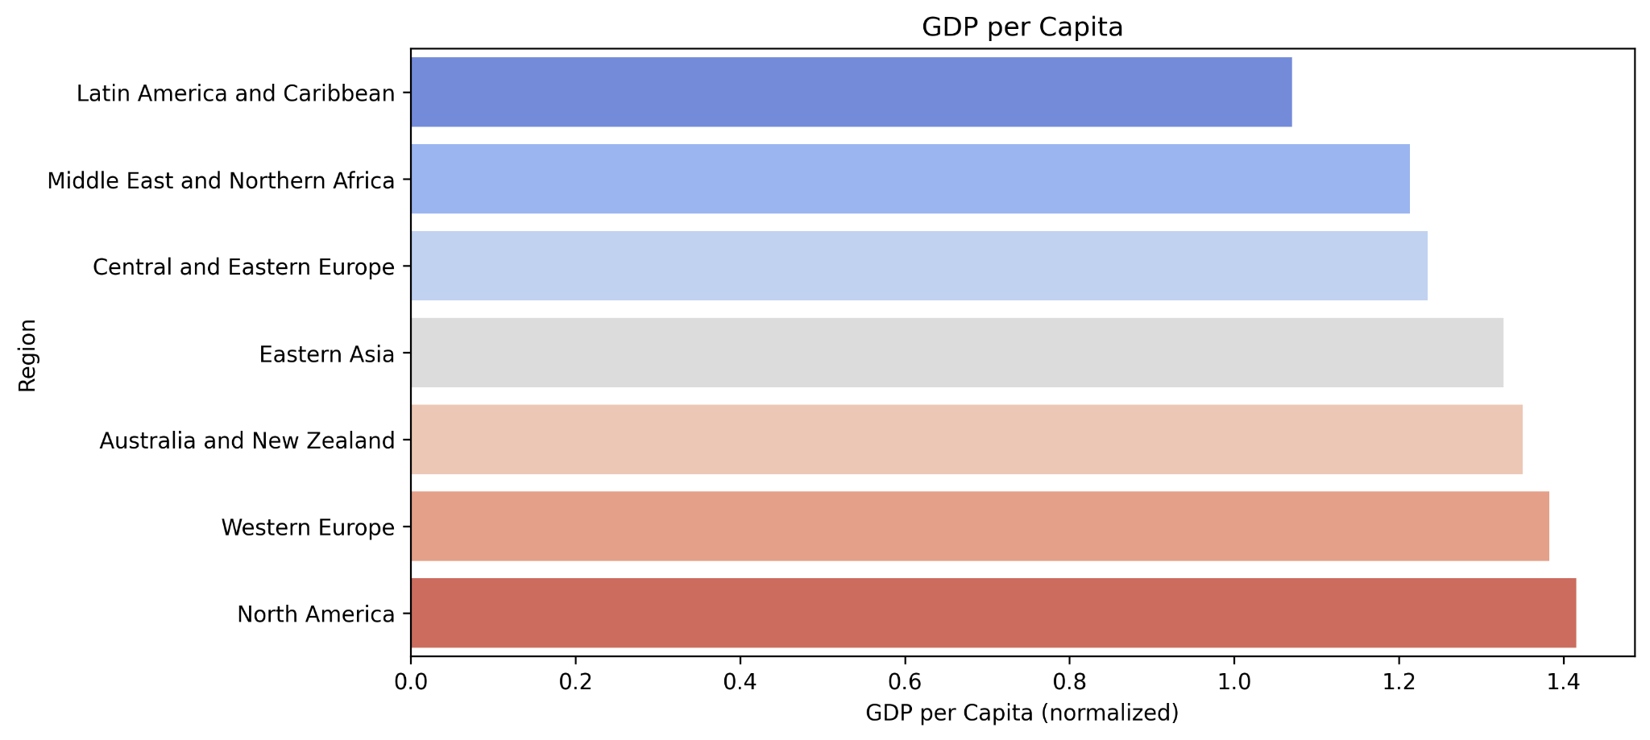
IRONHACK BOOTCAMP DA JAN 31
Who earns the most?
(score)

Slide 13
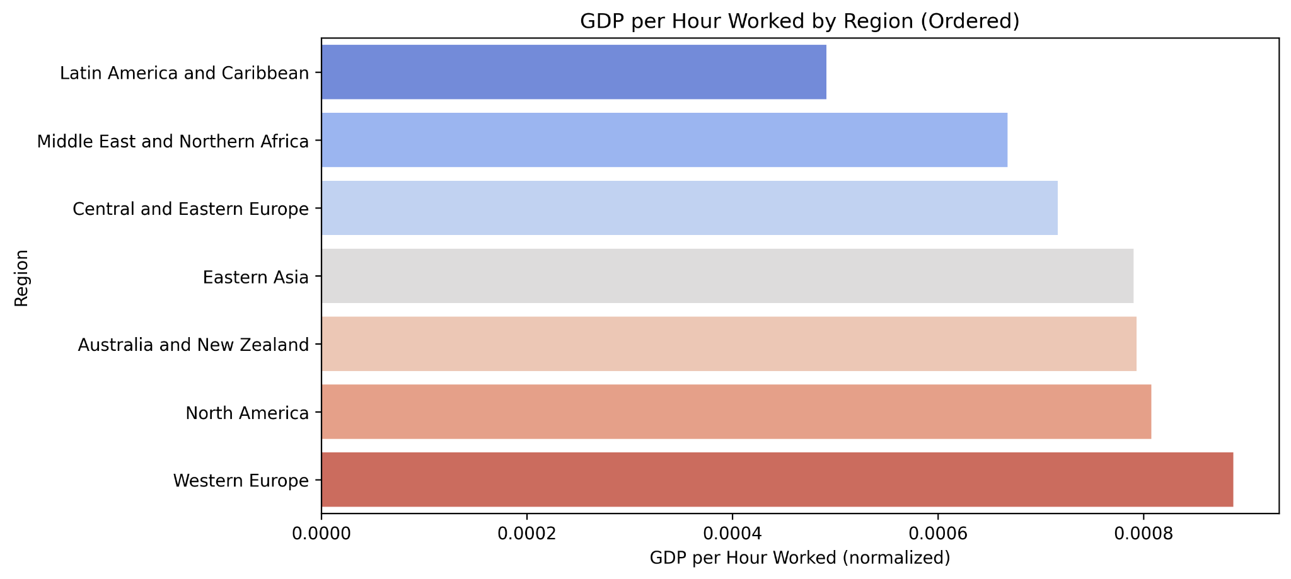
IRONHACK BOOTCAMP DA JAN 31
Who is the most productive?
Wealthier economies generally work fewer hours while maintaining high productivity
💡

Slide 14
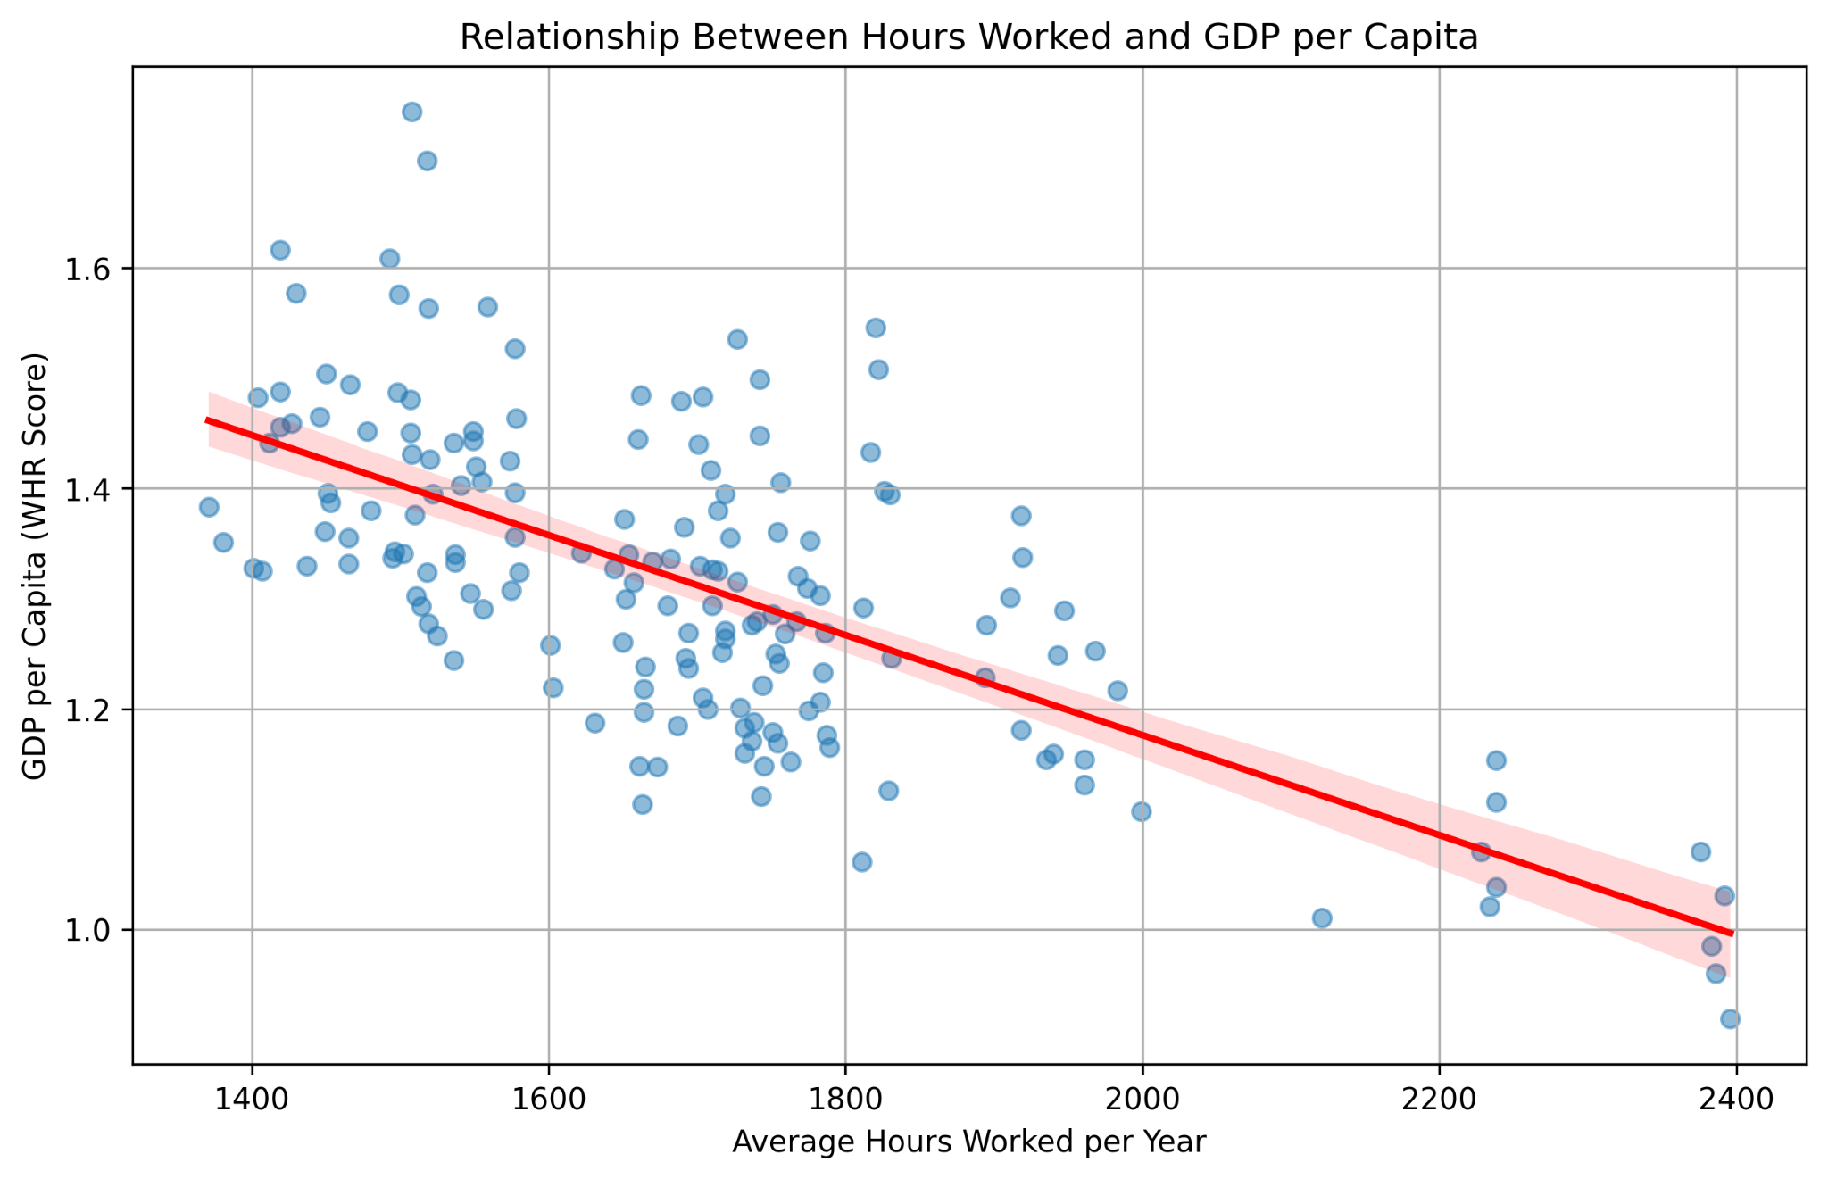
IRONHACK BOOTCAMP DA JAN 31
Big Picture: Does higher GDP mean less work?
It’s a bit unclear…
→ Technology
→ Labour Policies
→ Industry
→ Culture
All play a big role
Notes:
The correlation varies by region. In many cases, a negative correlation is evident, meaning more hours worked generally correlate with lower GDP per capita but there are many other factors which could impact this.

Slide 15
IRONHACK BOOTCAMP DA JAN 31
more_work = less_life? 💀

Slide 16
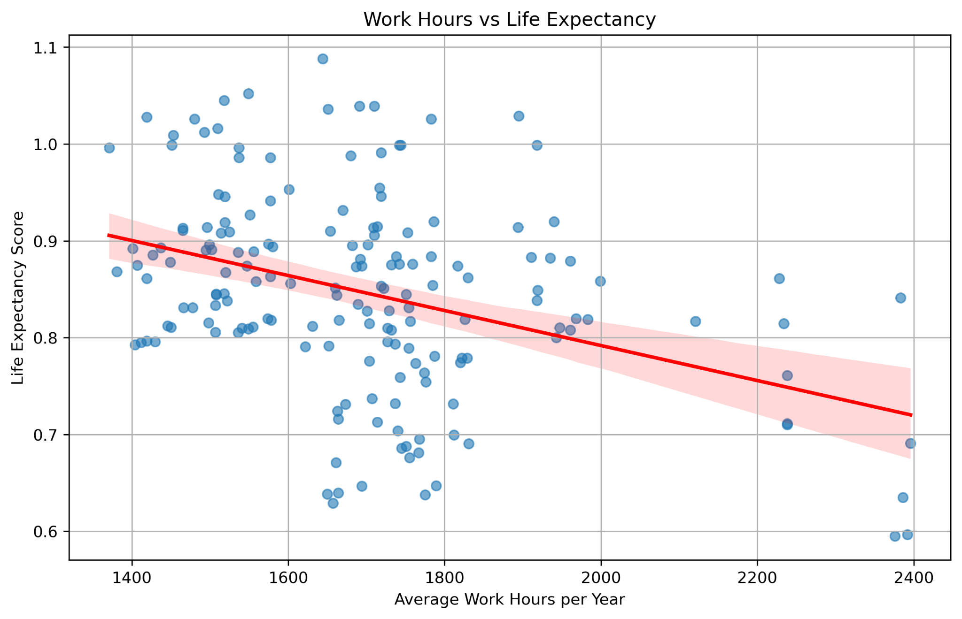
IRONHACK BOOTCAMP DA JAN 31
Do people who work less, live longer?
Hmm, not sure?
Notes:
The regression line again suggests a slightly negative relationship, showing that longer work hours are associated with lower life expectancy.
But the correlation is weak.

Slide 17
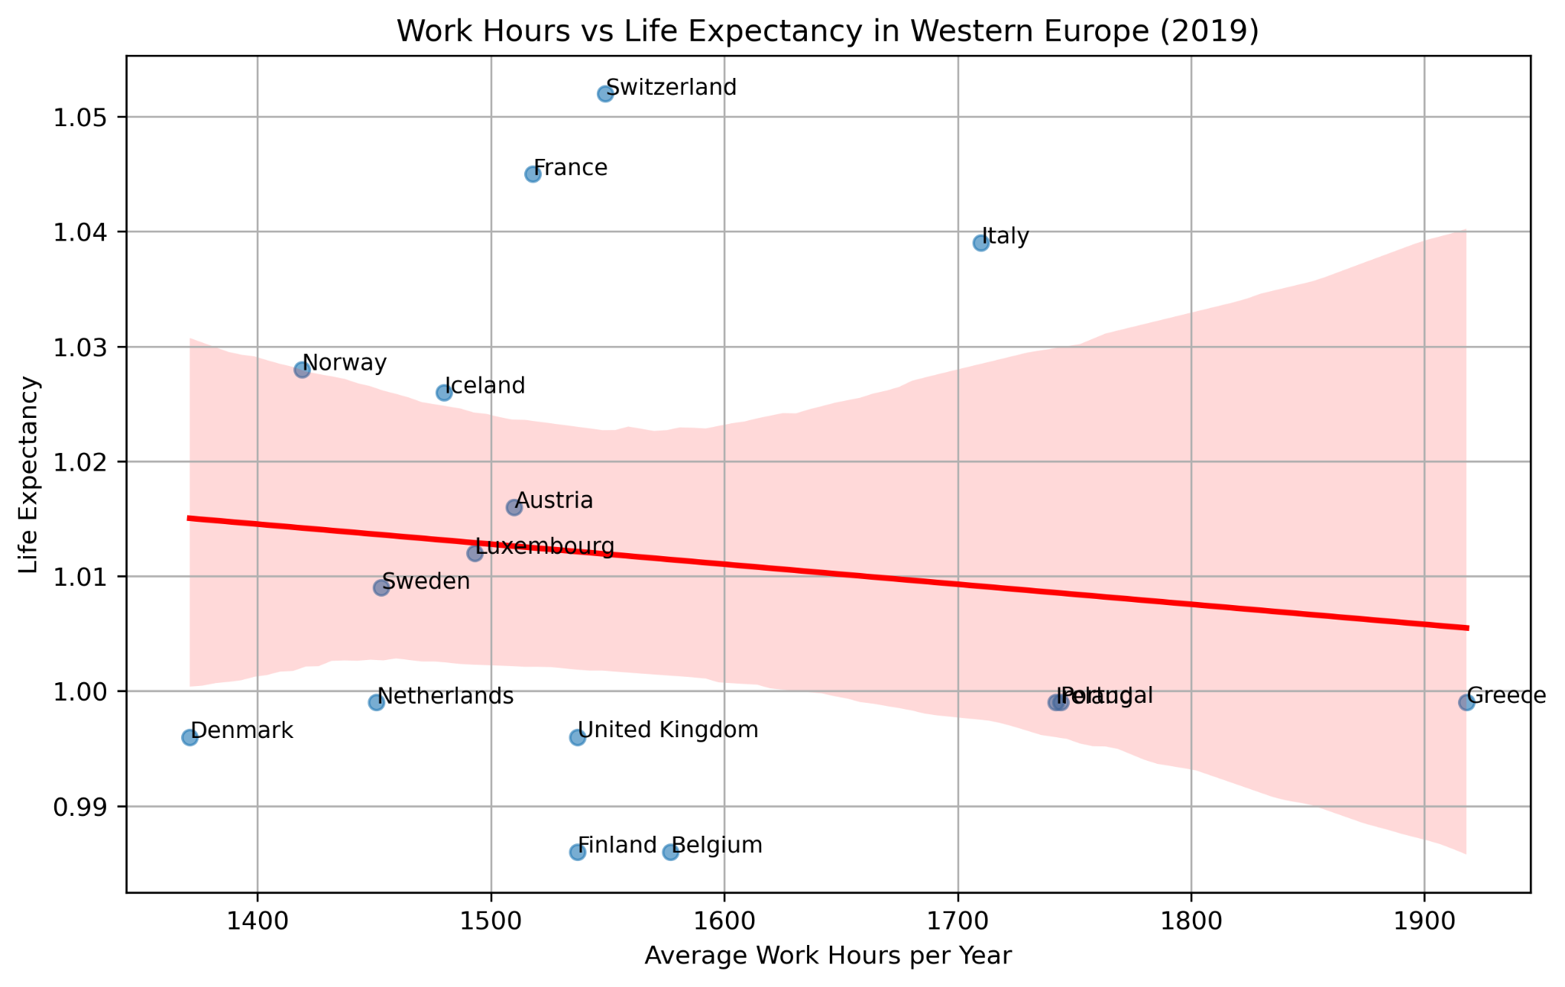
IRONHACK BOOTCAMP DA JAN 31
Do Europeans who work less, live longer?
Also not clear…
Longer life = cheese 🧀 + mountains 🏔️?
Notes:
The red regression line suggests a slight negative correlation, meaning that countries with higher work hours tend to have slightly lower life expectancy.
While the trend exists, the relationship does not appear to be extremely strong, implying that other factors (healthcare quality, lifestyle, and policies) also play a role.
Some outliers may exist, where countries with similar work hours have different life expectancy rates.

Slide 18
IRONHACK BOOTCAMP DA JAN 31
less_work = more_happiness? 🙏

Slide 19
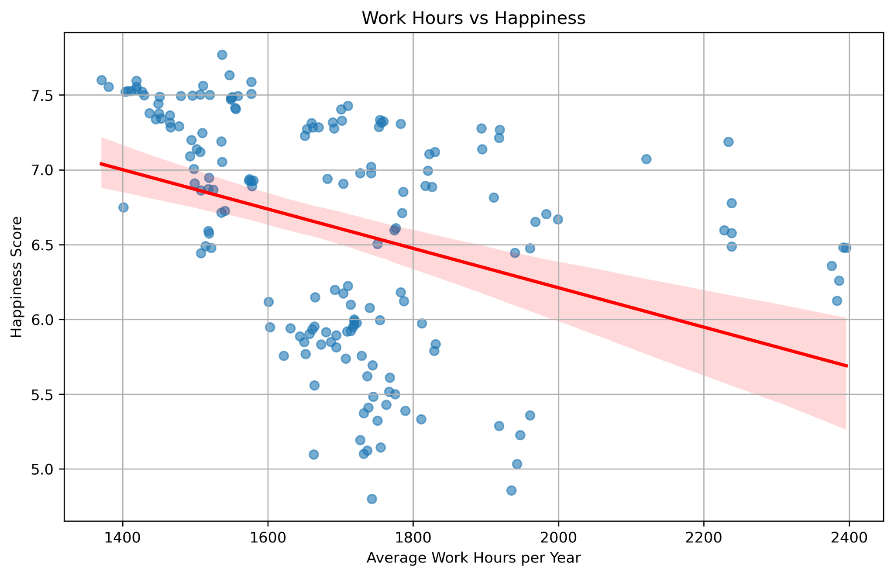
IRONHACK BOOTCAMP DA JAN 31
Are people who work less happier?
Somewhat true, but it’s still not totally clear
Notes:
The scatter plot shows a negative trend, suggesting that countries where people work fewer hours tend to report higher happiness scores.
The correlation coefficient between work hours and happiness is -0.37, confirming a moderate negative relationship.

Slide 20
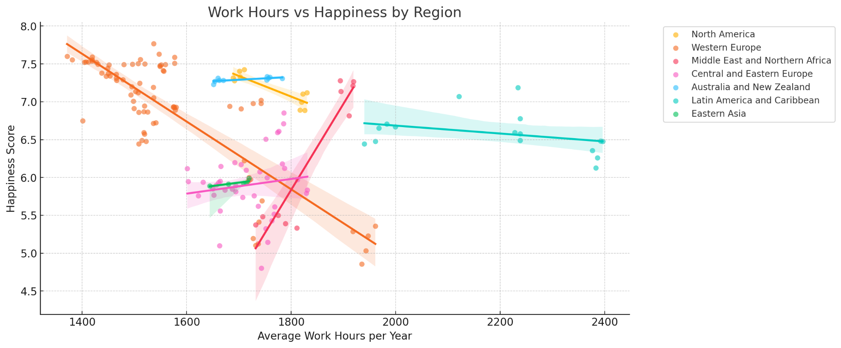
IRONHACK BOOTCAMP DA JAN 31
Are people who work less happier?
Notes:
We see some variation between regions
Negative correlation regions with more developed economies (less work, more happiness) while positive trend in less developed economies.

Slide 21
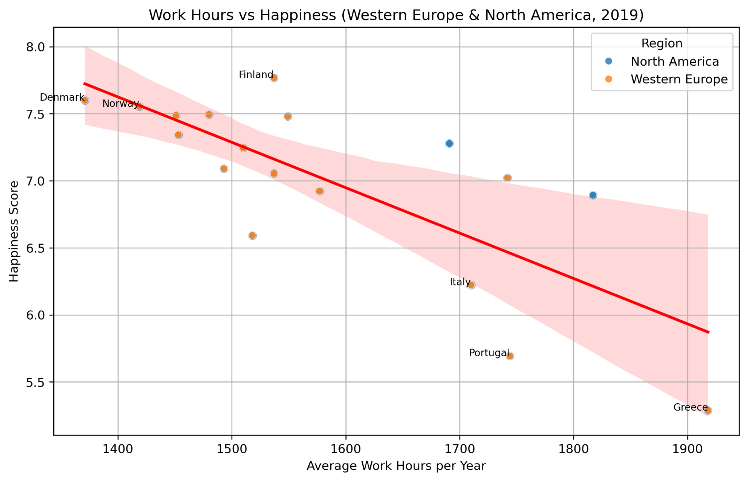
IRONHACK BOOTCAMP DA JAN 31
Are people who work less happier?
Notes:
Top 5 happiest countries in Western Europe (2019):
These countries tend to have moderate to lower work hours compared to the regional average.
Strong social support systems, better work-life balance, and high economic development may contribute to their happiness levels.
Bottom 5 least happy countries in Western Europe (2019):
Some of these nations tend to have longer work hours.
Other factors beyond work hours—such as economic challenges, lower social support, or governance issues—may contribute to their lower happiness scores.

Slide 22
IRONHACK BOOTCAMP DA JAN 31
Conclusions
Less working hours does correlate with higher happiness and longer lives…
But it’s not a very strong correlation.
Other factors such as economic stability, governance, and quality of life likely play a role beyond just working hours.
Next Steps
Refine our analysis further, looking into more factors that could impact happiness and productivity
Share findings with governments and businesses → Make the case for a standard 4 day work week?

Slide 23

Elohor, Mike

